Slide 1



what it
feels like
[my velvet throw]
Everything blue is a guide. Delete it before you download.
Notes:
Slide 1. Hook. Swap in a photo of your product being squeezed or touched. Edit [my velvet throw].

Slide 2

[you can't touch it
through a screen]
[so here's how it feels]
Notes:
Slide 2. Second hook: Instagram often shows a carousel starting on slide 2, so this one works as a cover on its own. No photo needed. Edit both [bracket] lines.

Slide 3
[soft]
Notes:
Slide 3. Close-up 1: swap in its photo and type the feeling.

Slide 4
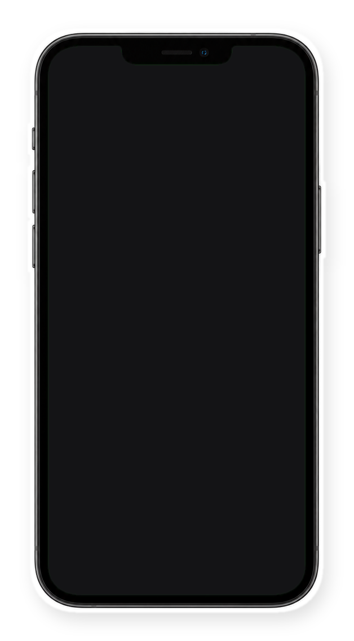

sound on
[you'll hear it]
Notes:
Slide 4. Swap in a screenshot or still of the satisfying clip for the phone screen. Edit the line.

Slide 5



[smooth]
Notes:
Slide 5. Close-up 2: swap in its photo and type the feeling.

Slide 6



in three words
[smooth]
[soft]
[cozy]
Notes:
Slide 6. The three feelings: a photo and a word for each.

Slide 7
[Product name]
Notes:
Slide 7. Swap in a photo of the whole product. Type its name.

Slide 8


Comment
"[KEYWORD]"
Notes:
Slide 8. Swap in a photo of your product. Type your keyword. Caption to start from (CTA in the first two sentences, 3 hashtags): Comment [KEYWORD] and I will send you [the link]. [One line of real context: who it helps or how you use it.] #[tag] #[tag] #[tag]

